Slide 1
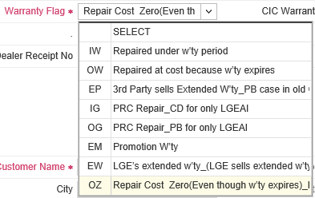
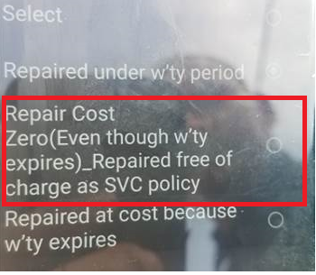
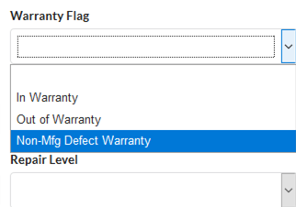
Service instruction
[Instruction] OZ code : One of the warranty flags in the SVC claim
Symptoms | SVC due to customer environment, not product problem / damages by delivery or installation / Customer’s fault, | Note | Warranty Exceptions Page 2 (Front loader) Warranty Exceptions Page 3 (Top loader)
Cause | not plugged in / plumbing or installation issue / outlet no power / the inlet hoses are installed in reverse
Note: Put the warranty flag with “OZ if the cases are warranty exceptions * OZ code explanation Use Warranty flag “OZ”, When we didn’t get paid for what was categorized OOW (Because of customer’s fault or environment impact) * The warranty exception cases are listed at Page 2 and 3
How to put the OZ code in warranty flag at GSFS+, mobile GSFS+ and SVC Power
GSFS+
[OZ]
Mobile GSFS+
[Repair Cost Zero]
SVC Power
[Non-Mfg Defect Warranty]
Page 1

Slide 2

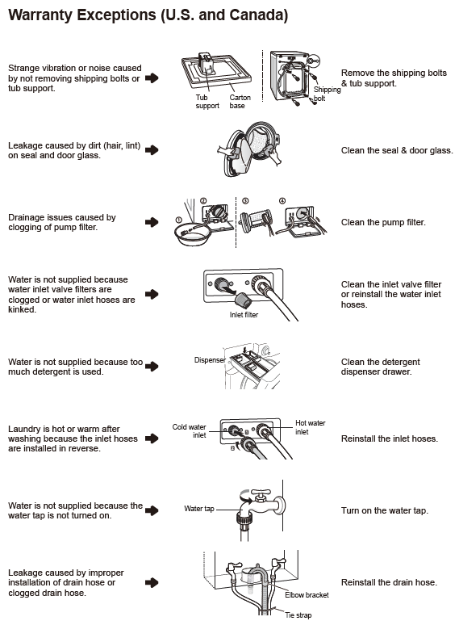
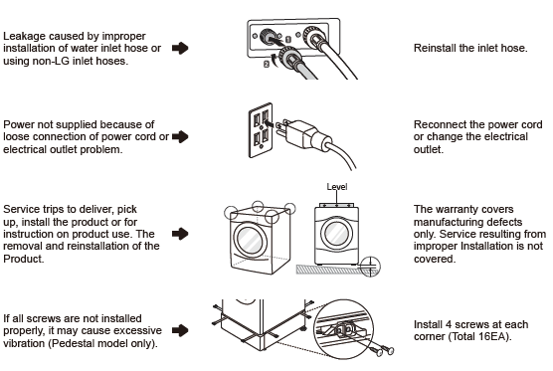
This information is included
in the owner manual
Page 2

Slide 3
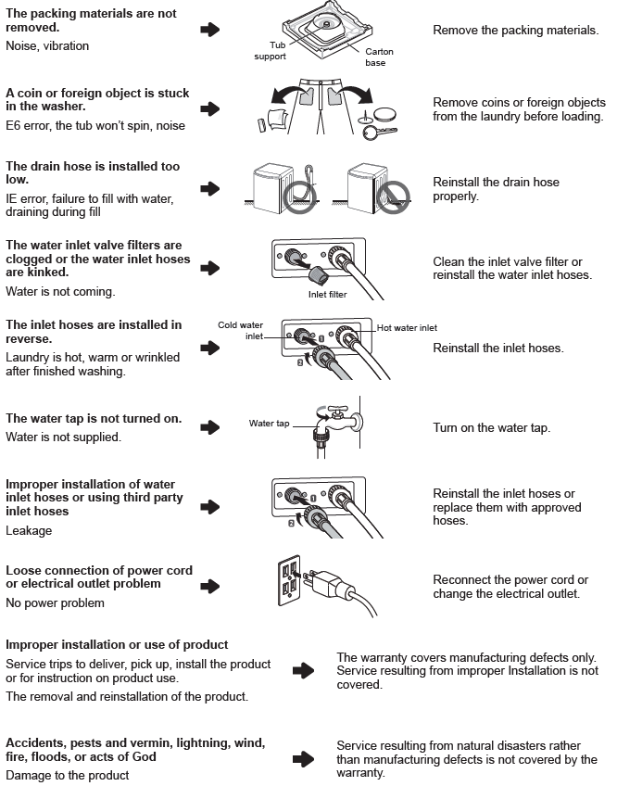
This information is
included in the owner
manual
Page 3

